Slide 1

Secure data hiding in images using steganography
CAPSTONE PROJECT
Presented By: Risul Dev
Department : Computer Science and Engineering
College Name: East West Institute Of Technology

Slide 2
OUTLINE
Problem Statement
Technology used
Wow factor
End users
Result
Conclusion
Git-hub Link
Future scope

Slide 3

Problem Statement
With increasing digital communication, data security is crucial. Traditional encryption is easily detectable. Steganography provides a way to hide data within images securely.

Slide 4
Technology used
- Programming Language: Python
- Libraries: OpenCV, NumPy, Pillow
- Platforms: Windows/Linux, Jupyter Notebook, PyCharm, Command prompt

Slide 5
Wow factors
- High security with minimal distortion
- Uses LSB (Least Significant Bit) technique
- Can embed encrypted data within images
- Hard to detect through visual inspection

Slide 6
End users
- Cybersecurity Professionals
- Journalists and Whistleblowers
- Military and Intelligence Agencies
- Secure Communication Users

Slide 7
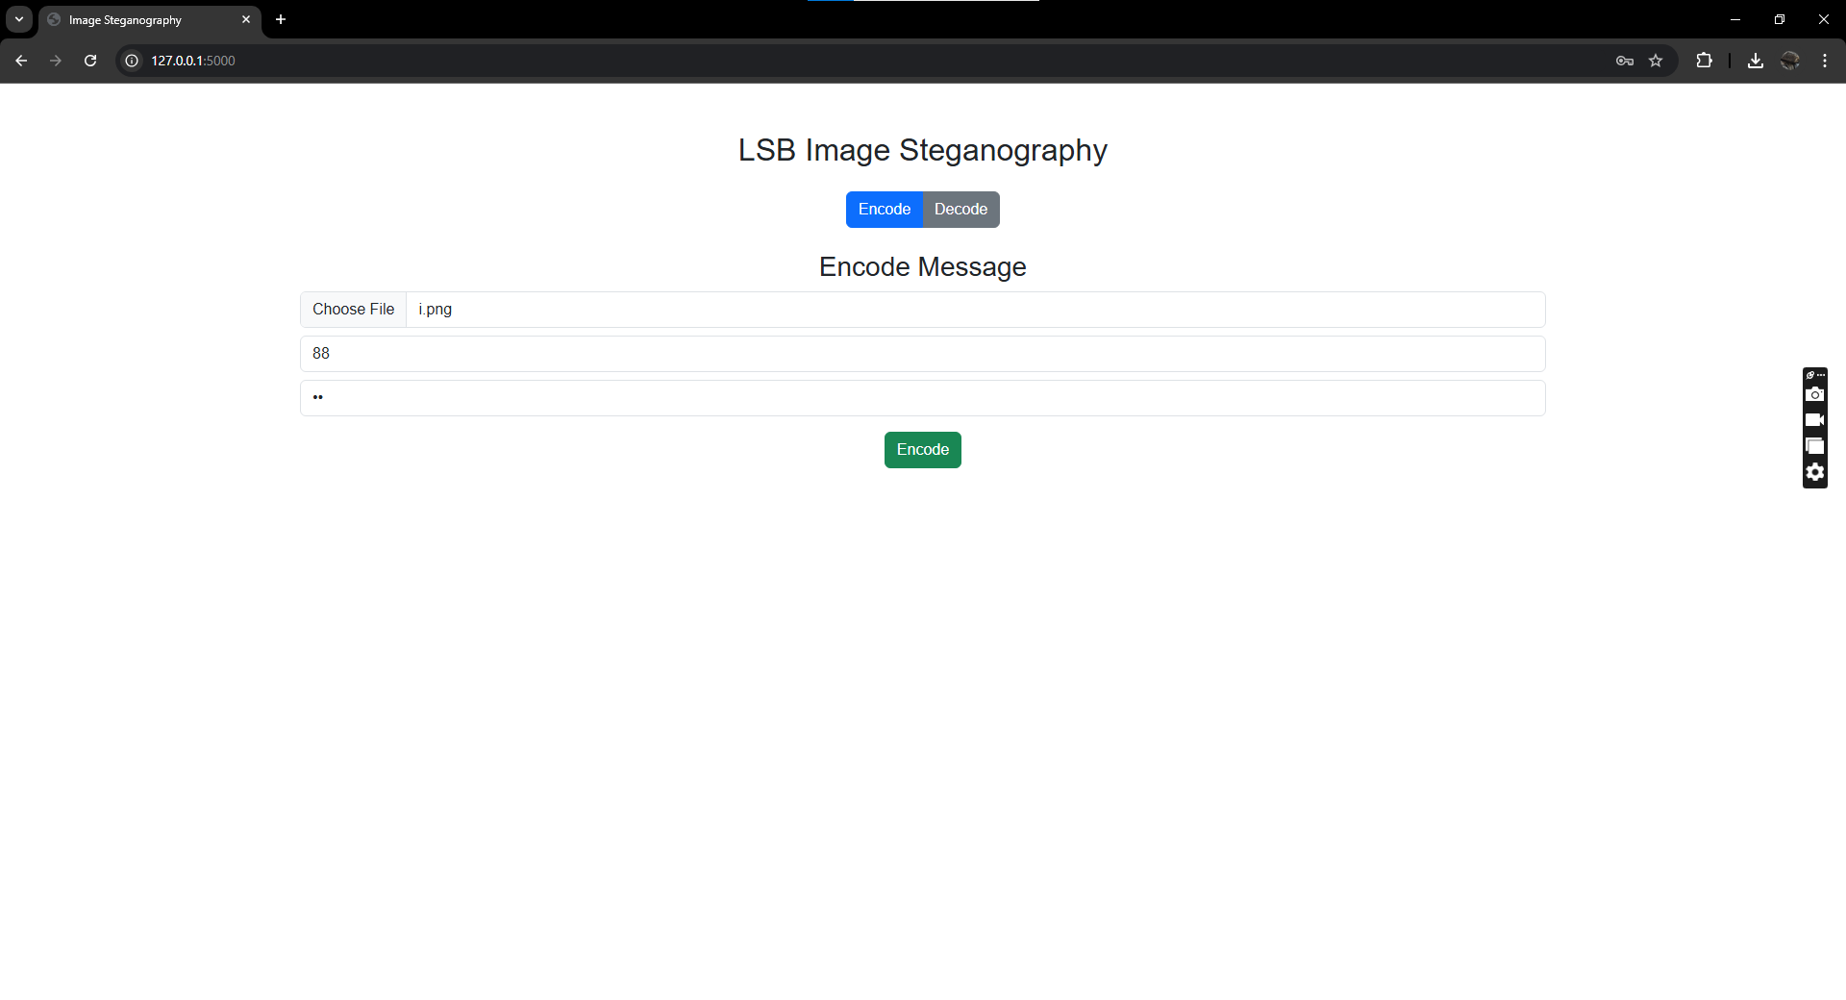
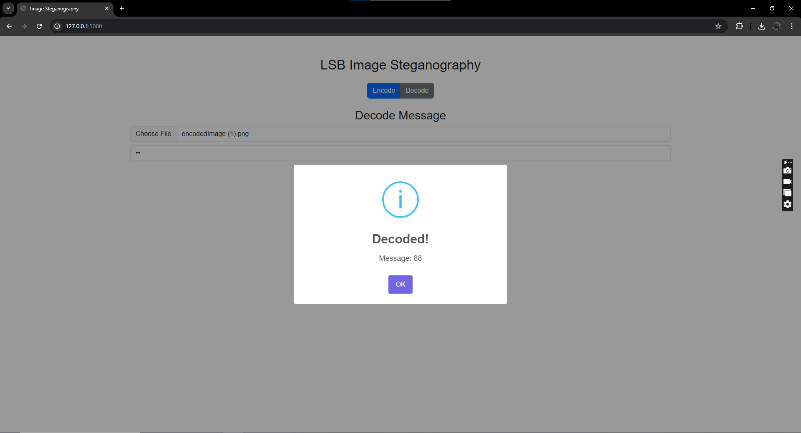
Results
Successfully implemented image steganography with hidden data extraction. The project ensures data security without raising suspicion.

Slide 8

Conclusion
This project demonstrates an efficient method of securing data using steganography. It offers an additional layer of security alongside encryption.

Slide 9
GitHub Link
https://github.com/Risuldev94/Project-ACITE.git

Slide 10
- Improved compression with steganography
- AI-powered steganalysis detection
- Integration with blockchain for enhanced security
Future scope(optional)

Slide 11
THANK YOU

